Slide 1
Financial Analysis of MANA
By Tyson Horsewell, Husna Nasution and Bilal Rasheed

Slide 2
The Premise - A Tech Stock Buyer’s Guide
Investing has been known as a way to put the money you own to work
By placing money in companies and products, you can potentially grow wealth over time significantly
However, poor company performance can result in losses, which hinders investment eagerness
By developing a financial guide, we can inform potential investors of a company’s value for investment

Slide 3






Technologies Used
ipyWidgets
Plotly
yfinance

Slide 4


Data Sources Used
Historical data from NASDAQ
https://www.nasdaq.com/market-activity/quotes/historical
yfinance API
https://pypi.org/project/yfinance/

Slide 5
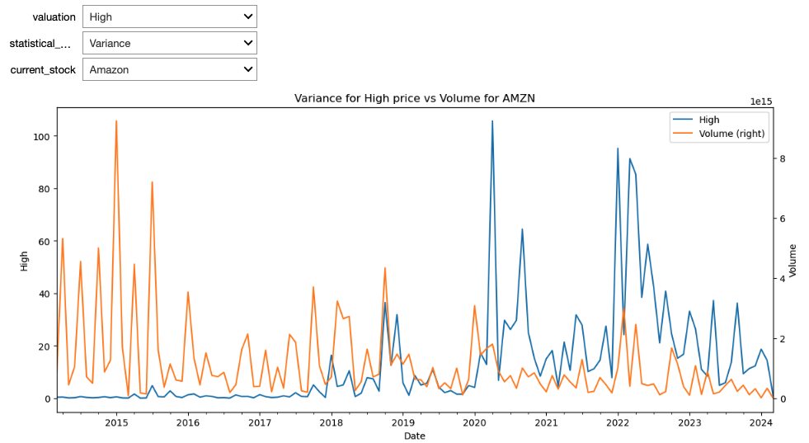
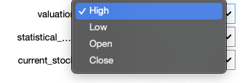
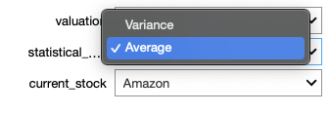
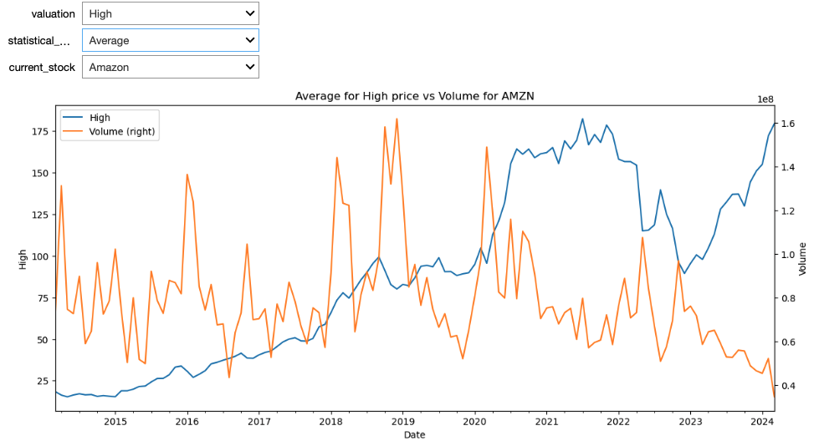
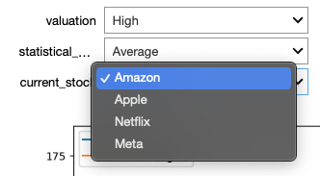
Examining Data Variance
Interactivity
Graphs

Slide 6
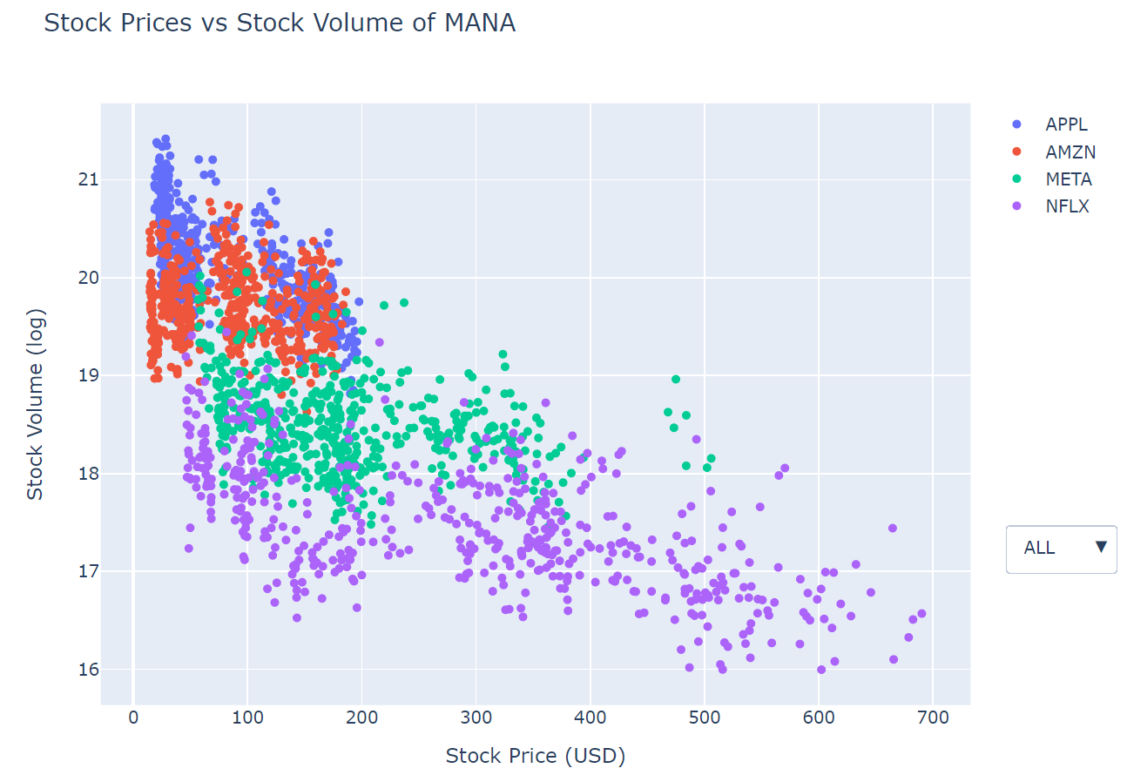
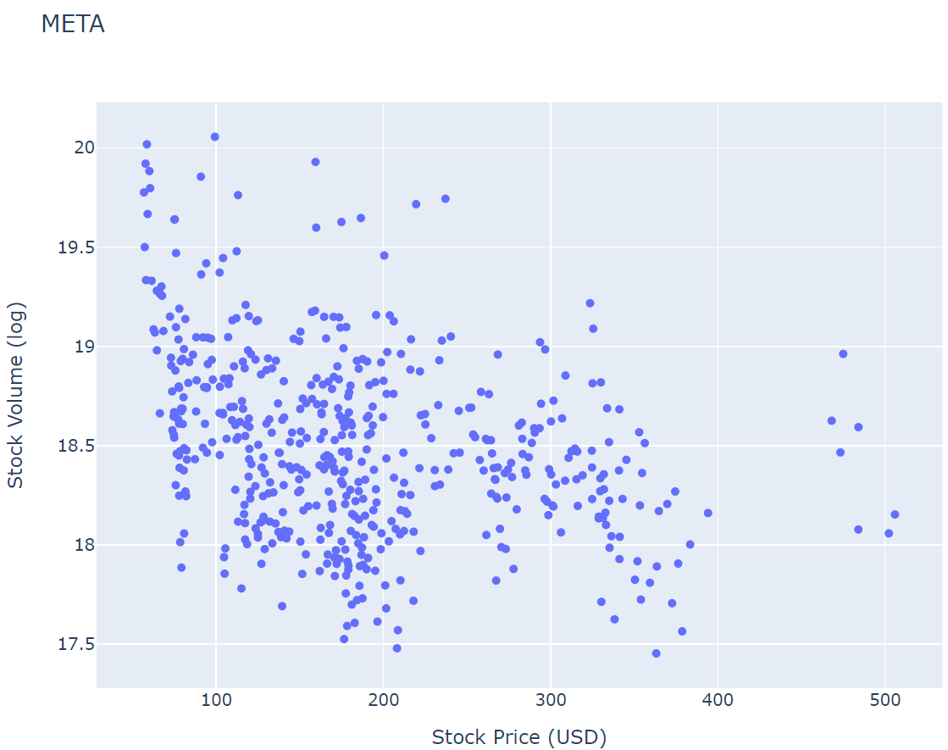
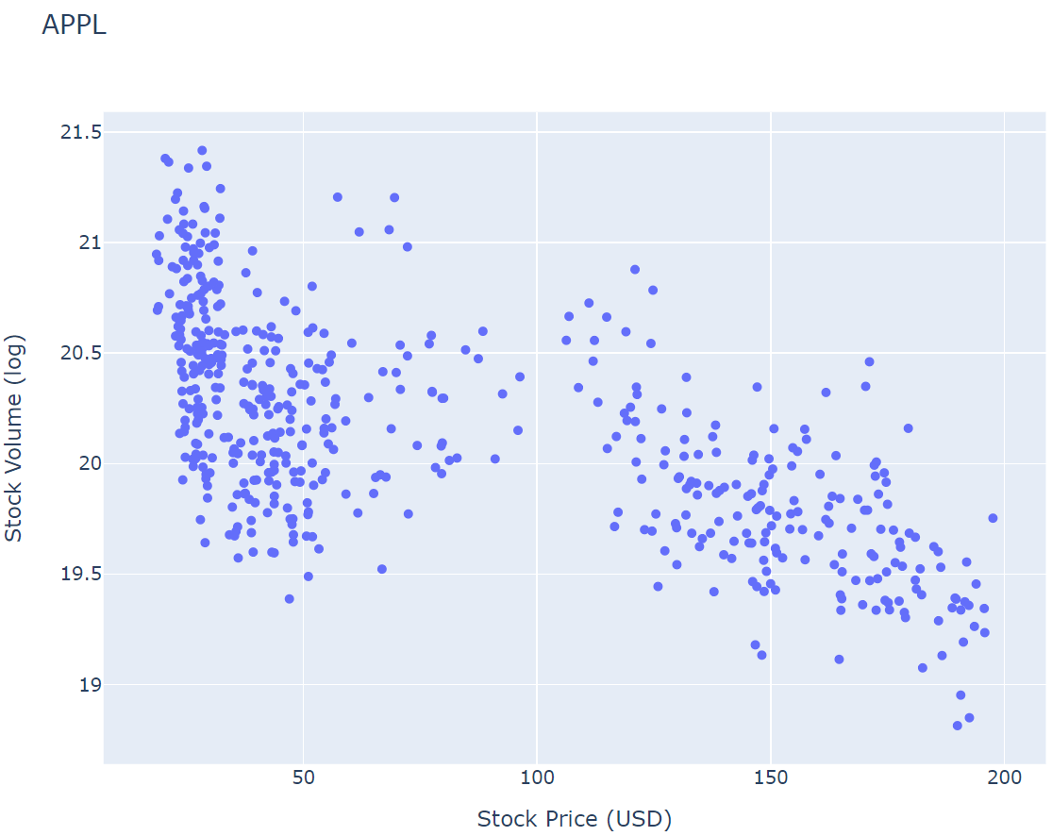
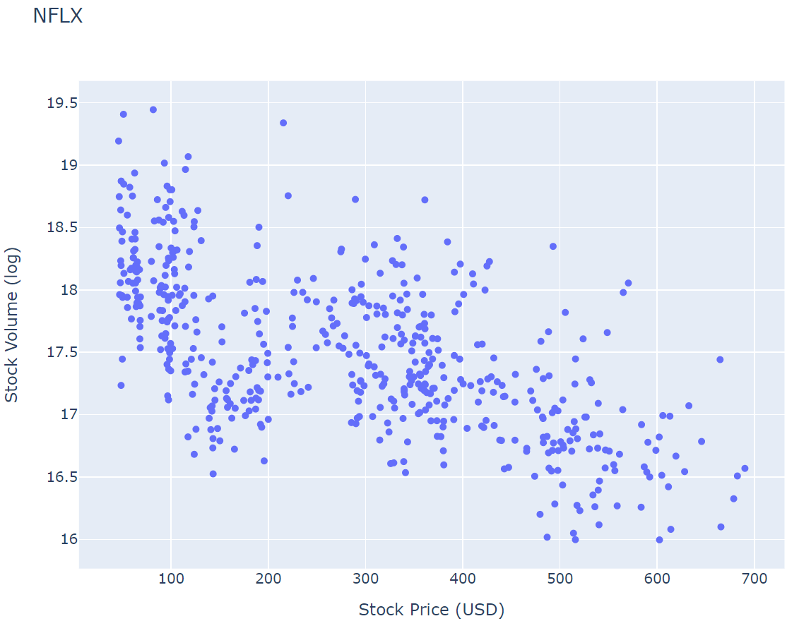
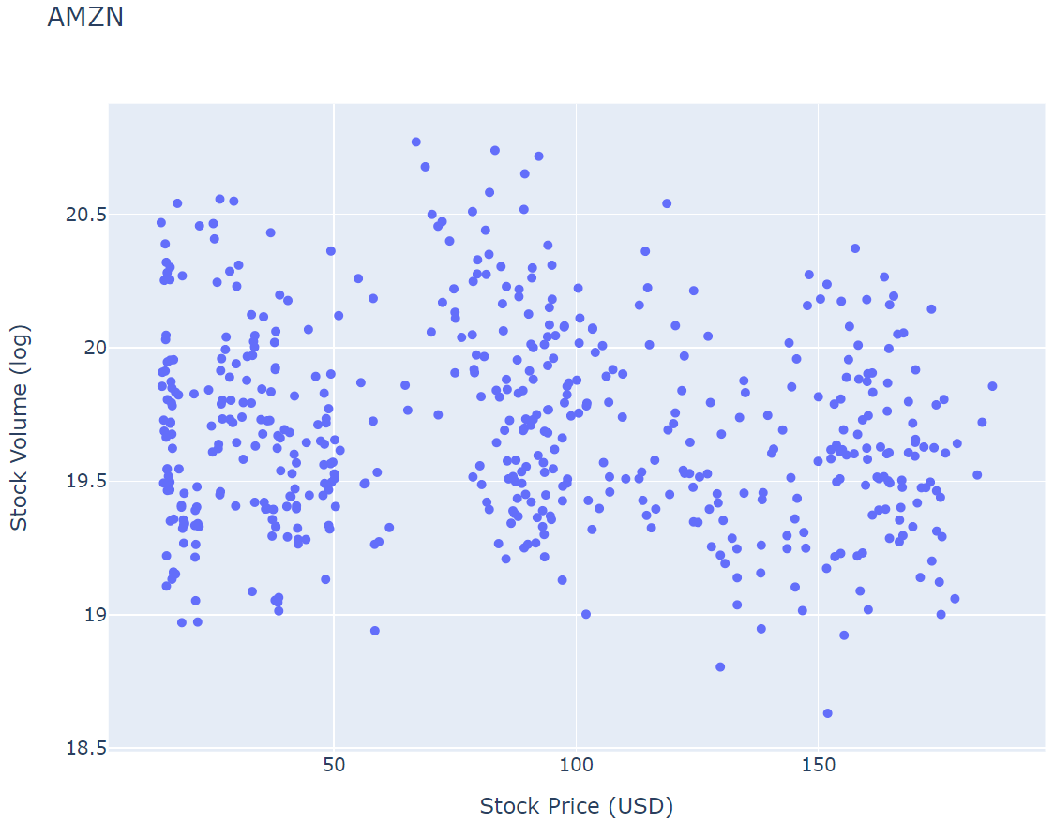
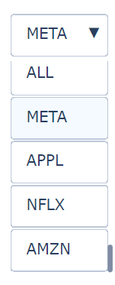
Stock Volume vs Stock Price

Slide 7
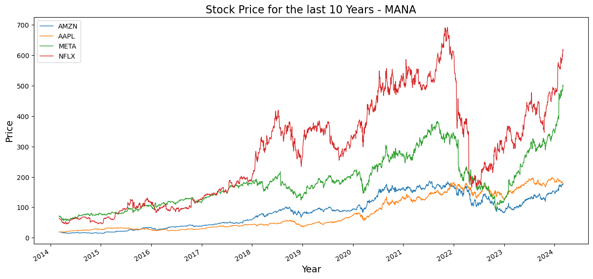

Slide 8
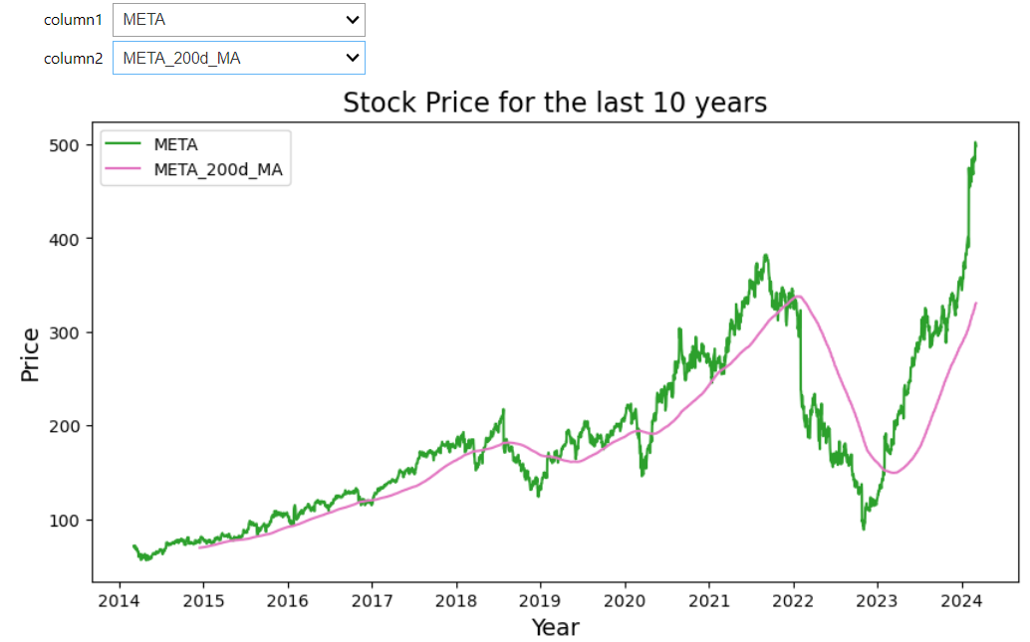

Slide 9
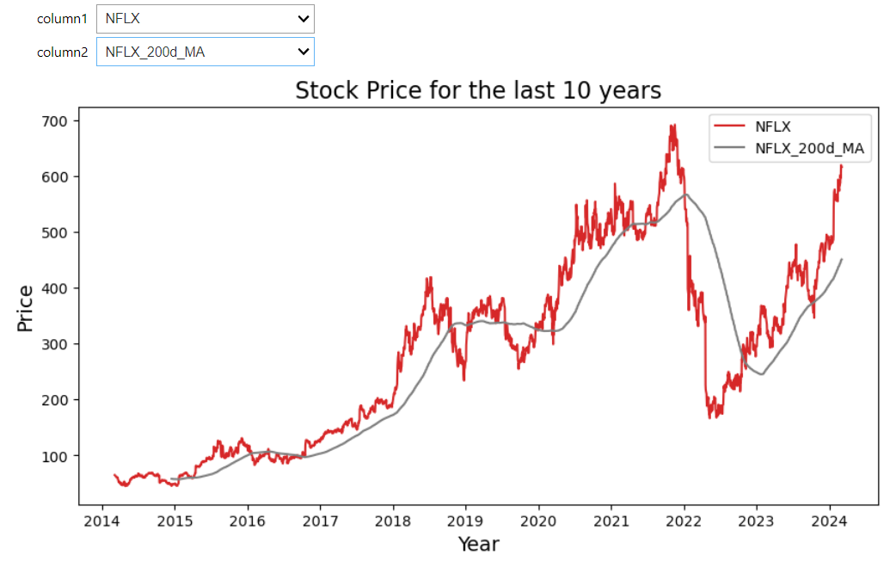

Slide 10
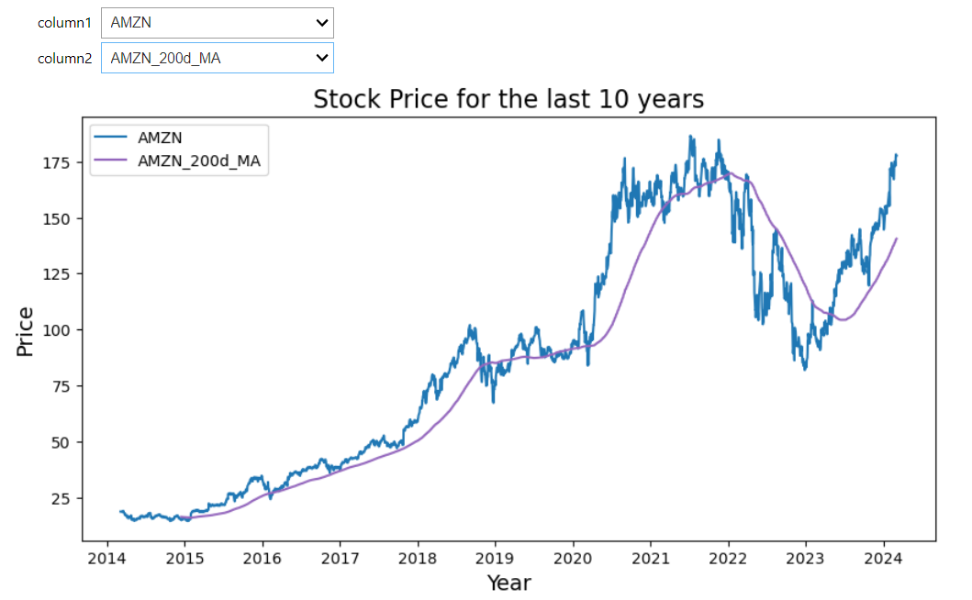

Slide 11
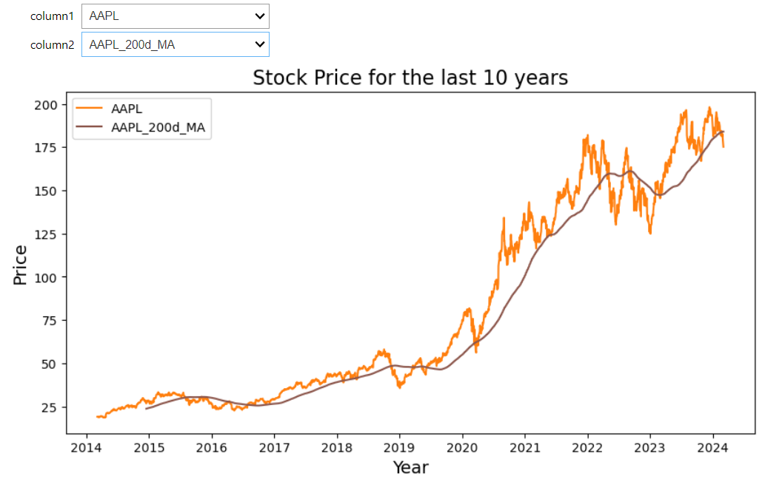

Slide 12
Thank You For Your Time!

